Slide 1


Causality
Cause → Effect

Slide 2

Causality is a different concept than probability.
If rooster is crowing, there is high probability of sun rising.
But rooster crowing is not causing sun to rise.

Slide 3
Cause 🡒 Effect

Slide 4
Smoking 🡒 Lung Cancer

Slide 5
Praying to rain god 🡒 Rain

Slide 6
Fossil Fuels 🡒 Global Warming

Slide 7
Immigration 🡒 Violence

Slide 8
Immigration 🡒 Innovation

Slide 9
Facebook 🡒 Depression

Slide 10
Twitter 🡒 Echo Chamber

Slide 11
Cat crossing road 🡒 Bad Luck

Slide 12
Earth Rotation 🡒 Day and Night

Slide 13
Rooster Crowing 🡒 Sun Rising

Slide 14
Why do you need to understand causality?

Slide 15
Why do you need to understand causality?
You don’t want to be the rooster that thinks it’s crowing causes the sun to rise.

Slide 16
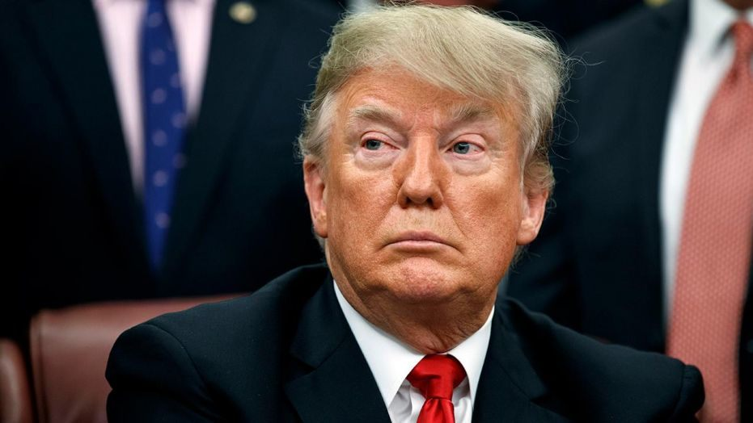
Why do you need to understand causality?

Slide 17
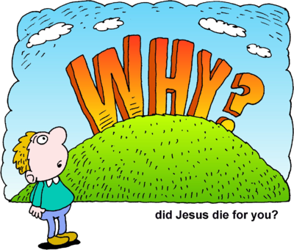
Why do you need to understand causality?

Slide 18
Why do you need to understand causality?
Why are some countries poor?
Does money cause happiness?
Does carbon-tax reduce carbon emissions?
Does educational game cause student engagement?
Does Horlicks cause brain growth?

Slide 19
How can we deduce Causality?

Slide 20
How can we deduce Causality?
Statistics 101: Correlation is not causation !

Slide 21
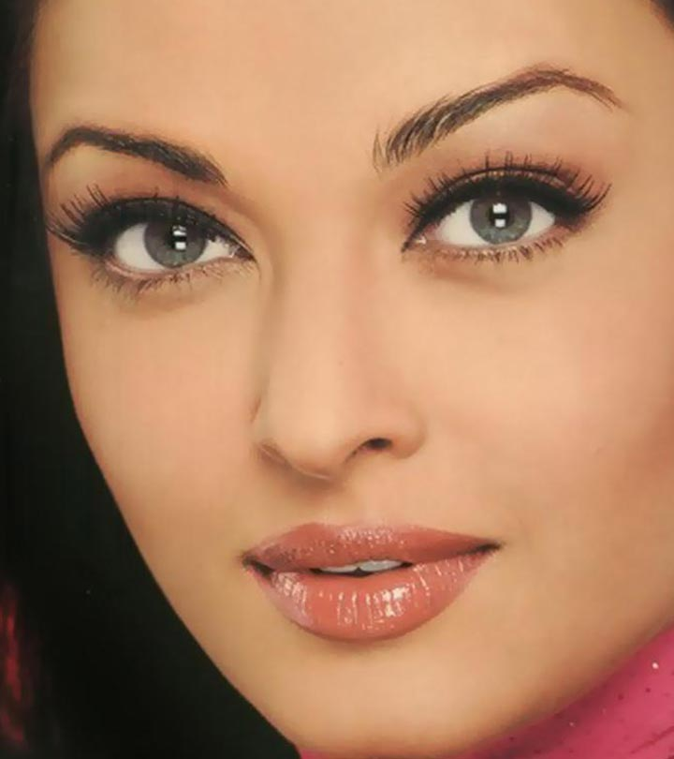
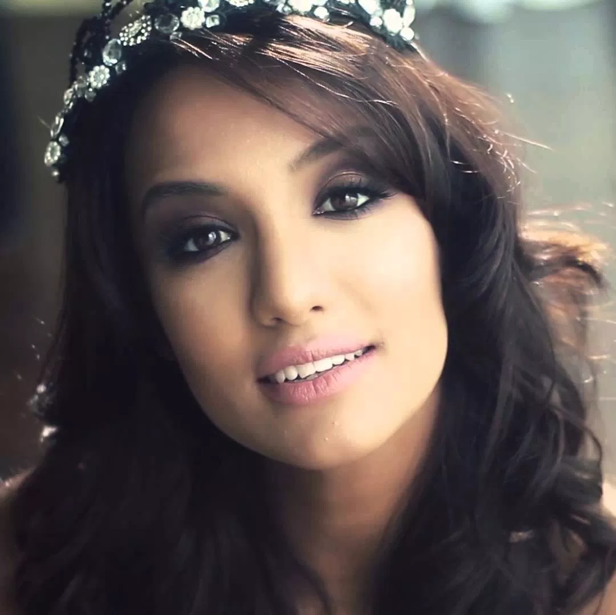
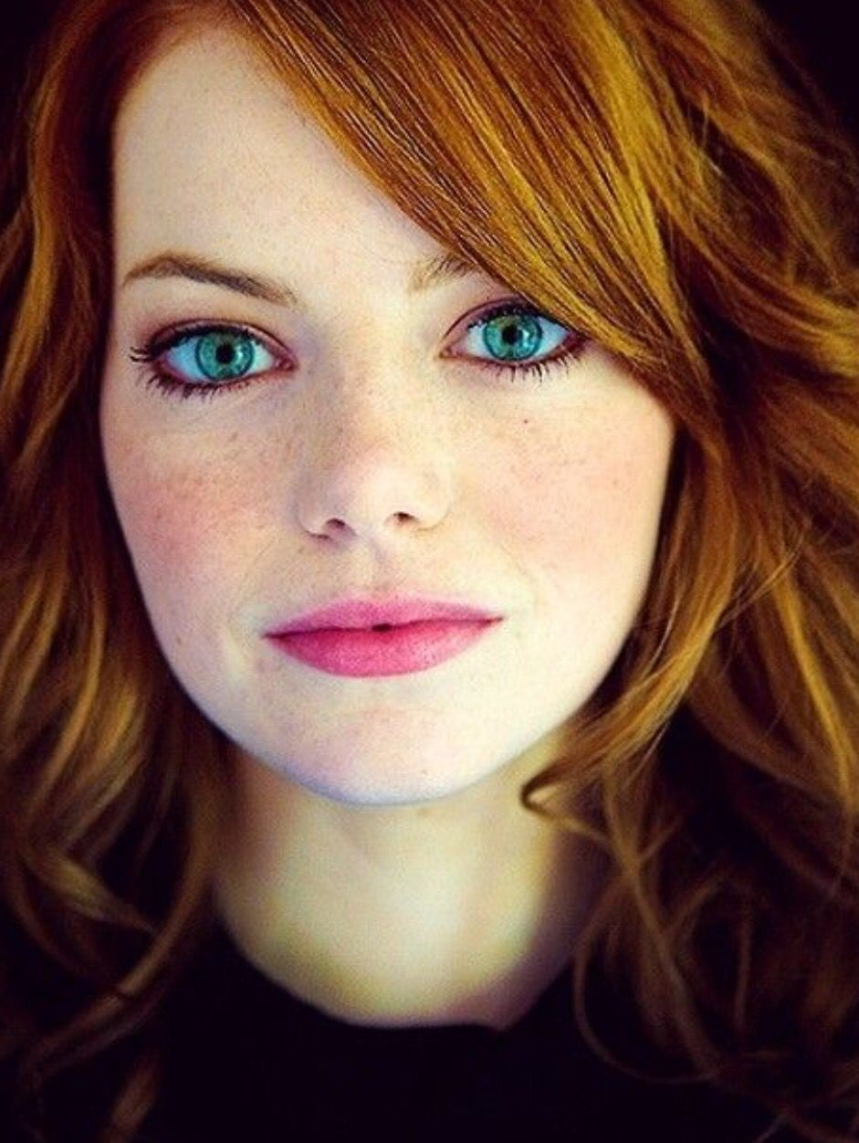
Color of Left Eye is correlated with Color of Right Eye.

Slide 22
Color of Left Eye is correlated with Color of Right Eye.
But is Color of Left Eye causing Color of Right Eye?

Slide 23
Color of Left Eye is correlated with Color of Right Eye.
But is Color of Left Eye causing Color of Right Eye?
If you change Color of Left Eye, does it change Color of Right Eye?

Slide 24

Statistics 101: Correlation is not causation !
Melanin
Color of Left Eye
Color of Right Eye
Color of Left Eye
Color of Right Eye

Slide 25

In a primary school,
Shoe Size is correlated with Spelling Ability
If you stretch their feet, will their spelling ability increase?

Slide 26
Statistics 101: Correlation is not causation !
Age
Shoe Size
Spelling Ability
Shoe
Size
Spelling
Ability

Slide 27
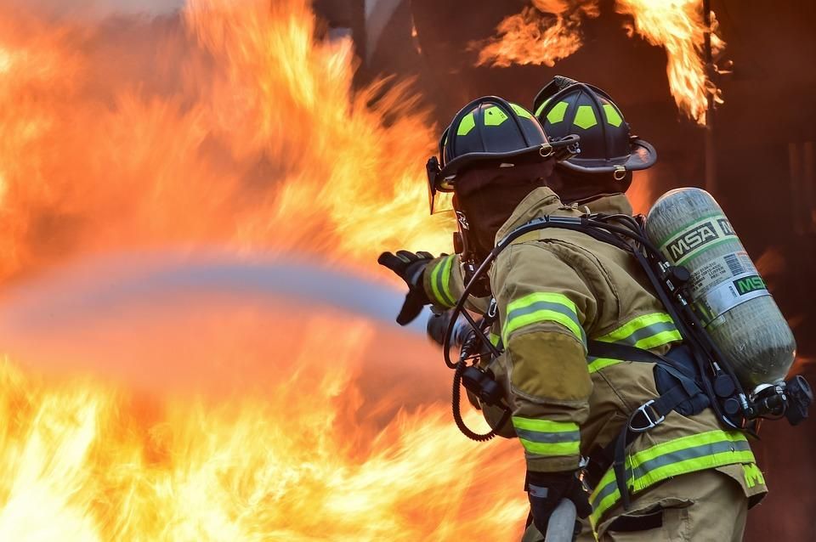
Simpson’s Paradox
Do firefighters present at fire create higher fire damage? There is a strong positive correlation between the number of firefighters present at a fire and the amount of fire damage.

Slide 28
Statistics 101: Correlation is not causation !
If correlation cannot guarantee causation, how can we deduce causation?

Slide 29
Statistics 101: Correlation is not causation !
If correlation cannot guarantee causation, how can we deduce causation?
If you change Color of Left Eye, does it change Color of Right Eye?

Slide 30
Statistics 101: Correlation is not causation !
If correlation cannot guarantee causation, how can we deduce causation?
If you change Color of Left Eye, does it change Color of Right Eye?
INTERVENTION

Slide 31
Causal Statements are about Interventions
If you intervene and change carbon-tax, does it change global emissions ?
If you intervene and change pollution, does it change citizen health ?
If you intervene and change education material, does it change student engagement?

Slide 32
Experiments with Randomized Controlled Trials
are the tools to identify Causality

Slide 33
Experiments with Randomized Controlled Trials
are the tools to identify Causality
Do educational games cause student engagement?

Slide 34

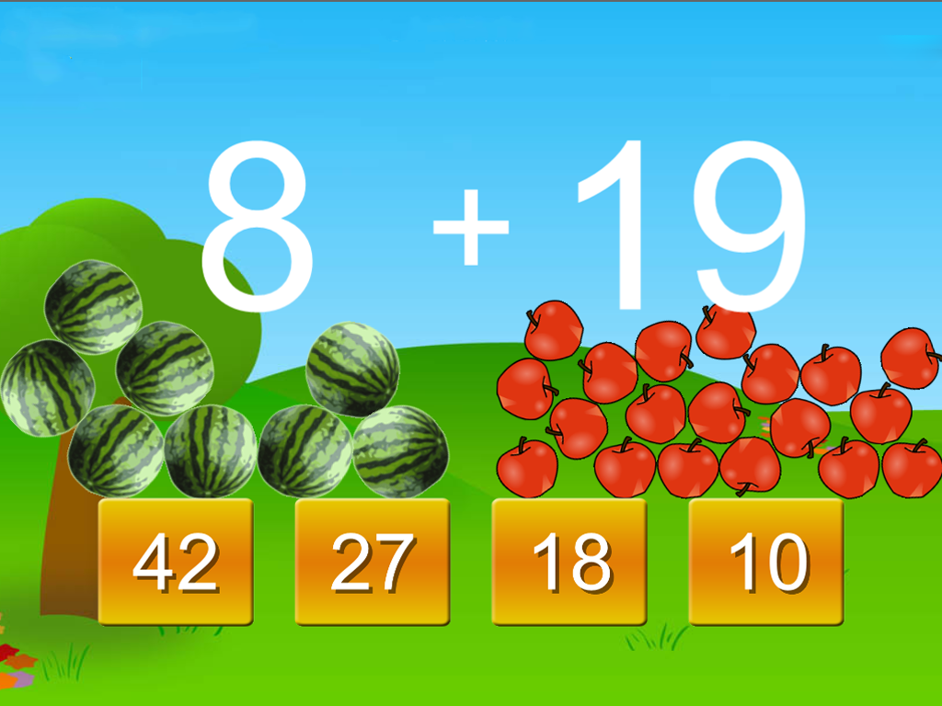
Do educational games cause student engagement?
Group A
Population
Compare Results
Group B
Random
assignment

Slide 35
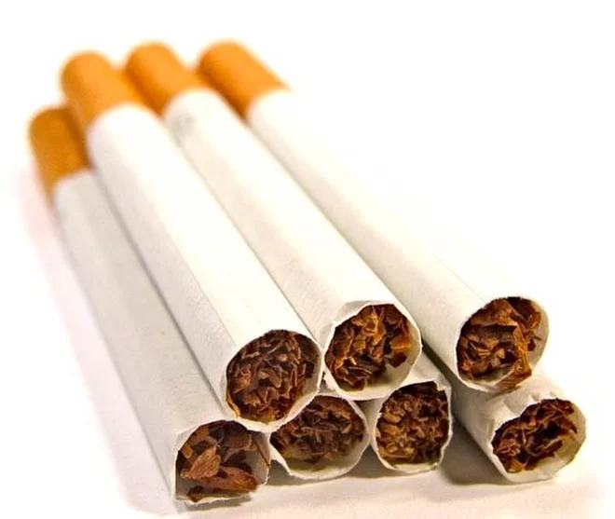
Does smoking cause lung cancer?
Group A
?
Population
Group B
Random
assignment

Slide 36
Does smoking cause lung cancer?
Does student motivation cause greater engagement?
Does being woman cause more workplace harassment?

Slide 37
Experiments with Randomized Controlled Trials
are the tools to identify Causality
But Randomized Controlled Trials are not always possible!!

Slide 38
Experiments with Randomized Controlled Trials
are the tools to identify Causality
But Randomized Controlled Trials are not always possible!!
What next?

Slide 39
Experiments with Randomized Controlled Trials
are the tools to identify Causality
But Randomized Controlled Trials are not always possible!!
What next?
Back to Statistics

Slide 40
Statistics 101: Correlation is not causation !

Slide 41
Statistics 101: Correlation is not causation !
BUT

Slide 42
Statistics 101: Correlation is not causation !
BUT Causation and Correlation are correlated.

Slide 43
Statistics 101: Correlation is not causation !
BUT Causation and Correlation are correlated.
Causation reveals itself in correlation.

Slide 44
Statistics 101: Correlation is not causation !
BUT Causation and Correlation are correlated.
Causation reveals itself in correlation.
If A and B are correlated, A causes B or B causes A or they share a latent common cause.

Slide 45
Causal Modeling is all about deducing
cause and effect from observational data.

Slide 46
Causal Modeling is all about deducing
cause and effect from observational data.
We will talk about limitations as well.

Slide 47
Causal Models
Causal models are graphical models that make the additional assumption that the links between nodes represent causal influence.
a link A🡒C means that if we intervene and change the value of A, then C will change.
A
C

Slide 48
Causal Models : Four types of Associations
Direct Effect
A
C
Smoking
Lung Cancer

Slide 49
Causal Models : Four types of Associations
2. Indirect Effect
A
B
C
Knowledge
Performance
Grade

Slide 50
Causal Models : Four types of Associations
2. Indirect Effect
A
B
C
Knowledge
Performance
Grade
Mediator

Slide 51
Causal Models : Four types of Associations
3. Spurious
Association
B
A
C
Age
Shoe Size
Spelling
Ability

Slide 52
Causal Models : Four types of Associations
3. Spurious
Association
B
A
C
Age
Shoe Size
Spelling
Ability
Confounder

Slide 53
Causal Models : Four types of Associations
4. Independent
A
C
B
Pollution
Smoking
Lung Cancer

Slide 54
Causal Models : Four types of Associations
4. Independent
A
C
B
Pollution
Smoking
Lung Cancer
Collider

Slide 55
Causal Models : Four types of Associations
Direct Effect
2. Indirect Effect
A
B
C
A
C
4. Independent
3. Spurious Association
A
C
B
B
A
C

Slide 56
Data
(Variables and Joint Probability Distribution)
Causal Structure
B
A
B
C
A
C
D
D

Slide 57
Data
(Variables and Joint Probability Distribution)
Causal Structure
Causal
Inference
B
A
B
C
A
C
D
D

Slide 58
Causal Inference
If there are only two variables , we have no way of telling which variable is cause and which is effect.
“Correlation is not causation”
This statement is true for single pairs of variables,
But when we have patterns of correlations, deducing causation is easier.

Slide 59
Causal Inference
Causal Inference uses d-separation : a criterion for deciding, from a given a causal graph, whether a set X of variables is independent of another set Y, given a third set Z. The idea is to associate "dependence" with "connectedness" (i.e., the existence of a connecting path) and "independence" with "unconnected-ness" or "separation".

Slide 60
Example 1: Two correlated variables
Causal Inference
A and B are correlated (dependent) with each other.
A
B
A
B
We have no way of telling whether A causes B or B causes A.
A
B

Slide 61
Example 2:
Causal Inference
A
B
A and B are correlated
B and C are correlated
A and C are not correlated.
B
C
A
C

Slide 62
There are three variables and we don’t know yet how the causal graph would look like. Let’s first create all possible Directed Acyclic Graph (DAG) from these three variables.
A
B
C

Slide 63
A
C
A
C
A
C
A
C
A
C
A
C
B
B
B
B
B
B
A
C
A
C
A
C
A
C
B
B
B
B
A
B
A
B
A
B
A
B
C
C
C
C
B
C
B
C
B
C
B
C
A
A
A
A

Slide 64
A
C
A
C
A
C
A
C
A
C
A
C
B
B
B
B
B
B
All graphs linking A and C will be invalid
A
C
A
C
A
C
A
C
B
B
B
B
A
B
A
B
A
B
A
B
C
C
C
C
B
C
B
C
B
C
B
C
A
A
A
A

Slide 65
A
C
A
C
A
C
A
C
A
C
A
C
B
B
B
B
B
B
A
C
A
C
A
C
A
C
B
B
B
B
A
B
A
B
A
B
A
B
C
C
C
C
B
C
B
C
B
C
B
C
A
A
A
A

Slide 66
There are four possible graphs
A
C
A
C
A
C
A
C
B
B
B
B

Slide 67
Using d-separation criterion, we select the second graph
A
C
A
C
A
C
A
C
B
B
B
B

Slide 68
Example 2:
Causal Inference
A and B are correlated
B and C are correlated
A and C are not correlated.
A
B
A
C
B
C
B
A
C

Slide 69
Example 2:
Causal Inference
A and B are correlated
B and C are correlated
A and C are not correlated.
A
B
A
C
B
C
B
A
C
But, can we always get this clear inference d-separation ?

Slide 70
Example 3:
Causal Inference
A
B
A and B are correlated B and C are correlated A and C are correlated
A and C are not correlated conditioned on B; A and C are conditionally independent on B
B
C
A
C
A
C
B

Slide 71
For this scenario, we have three possible Causal graphs
A
C
A
C
A
C
B
B
B

Slide 72
These are called Markov Equivalent Structures
For this scenario, we have three possible Causal graphs
A
C
A
C
A
C
B
B
B

Slide 73
Data
(Variables and Joint Probability Distribution)
Causal Structure
D-separation criterion is not enough. What next?
Causal
Inference
B
A
B
C
A
C
D
D

Slide 74
Data
(Variables and Joint Probability Distribution)
Causal Structure
Causal
Inference
B
A
B
C
A
C
D
Prior
Knowledge
D

Slide 75
Example 1: Two correlated variables
Causal Inference
A and B are correlated (dependent) with each other.
A
B
A
B
We have no way of telling whether A causes B or B causes A.
A
B

Slide 76
Example 1: Two correlated variables
But what if we know that A happened before B ?
Causal Inference
A and B are correlated (dependent) with each other.
A
B
A
B
We have no way of telling whether A causes B or B causes A.
A
B

Slide 77
Example 1: Two correlated variables
But what if we know that A happened before B ?
Causal Inference
A and B are correlated (dependent) with each other.
A
B
A
B
We have no way of telling whether A causes B or B causes A.
A
B

Slide 78
Example 1: Two correlated variables
But what if we know that A happened before B ?
Causal Inference
A and B are correlated (dependent) with each other.
A
B
A
B
We have no way of telling whether A causes B or B causes A.
A
B

Slide 79
Smoking
Lung Cancer
Smoking
Lung Cancer

Slide 80
What if we know B happened before A and C?
A
C
A
C
A
C
B
B
B

Slide 81
What if we know B happened before A and C?
A
C
A
C
A
C
B
B
B

Slide 82
What if we know B happened before A and C?
A
C
A
C
A
C
B
B
B

Slide 83
Shoe Size
Age
Spelling
Ability
Shoe Size
Age
Spelling
Ability
Shoe Size
Age
Spelling
Ability

Slide 84
But can temporal precedence (happening earlier in time) always determine cause-effect?
Rooster crowing happens earlier than sunrise.

Slide 85
Earth rotation
Circadian
Rhythm of rooster
Sunrise
Rooster crowing

Slide 86
And what if you cannot tell which variable occurred first?
Engagement
Performance
Engagement
Performance

Slide 87
Causal Modeling is not a perfect process.
It is still in relative infancy!

Slide 88
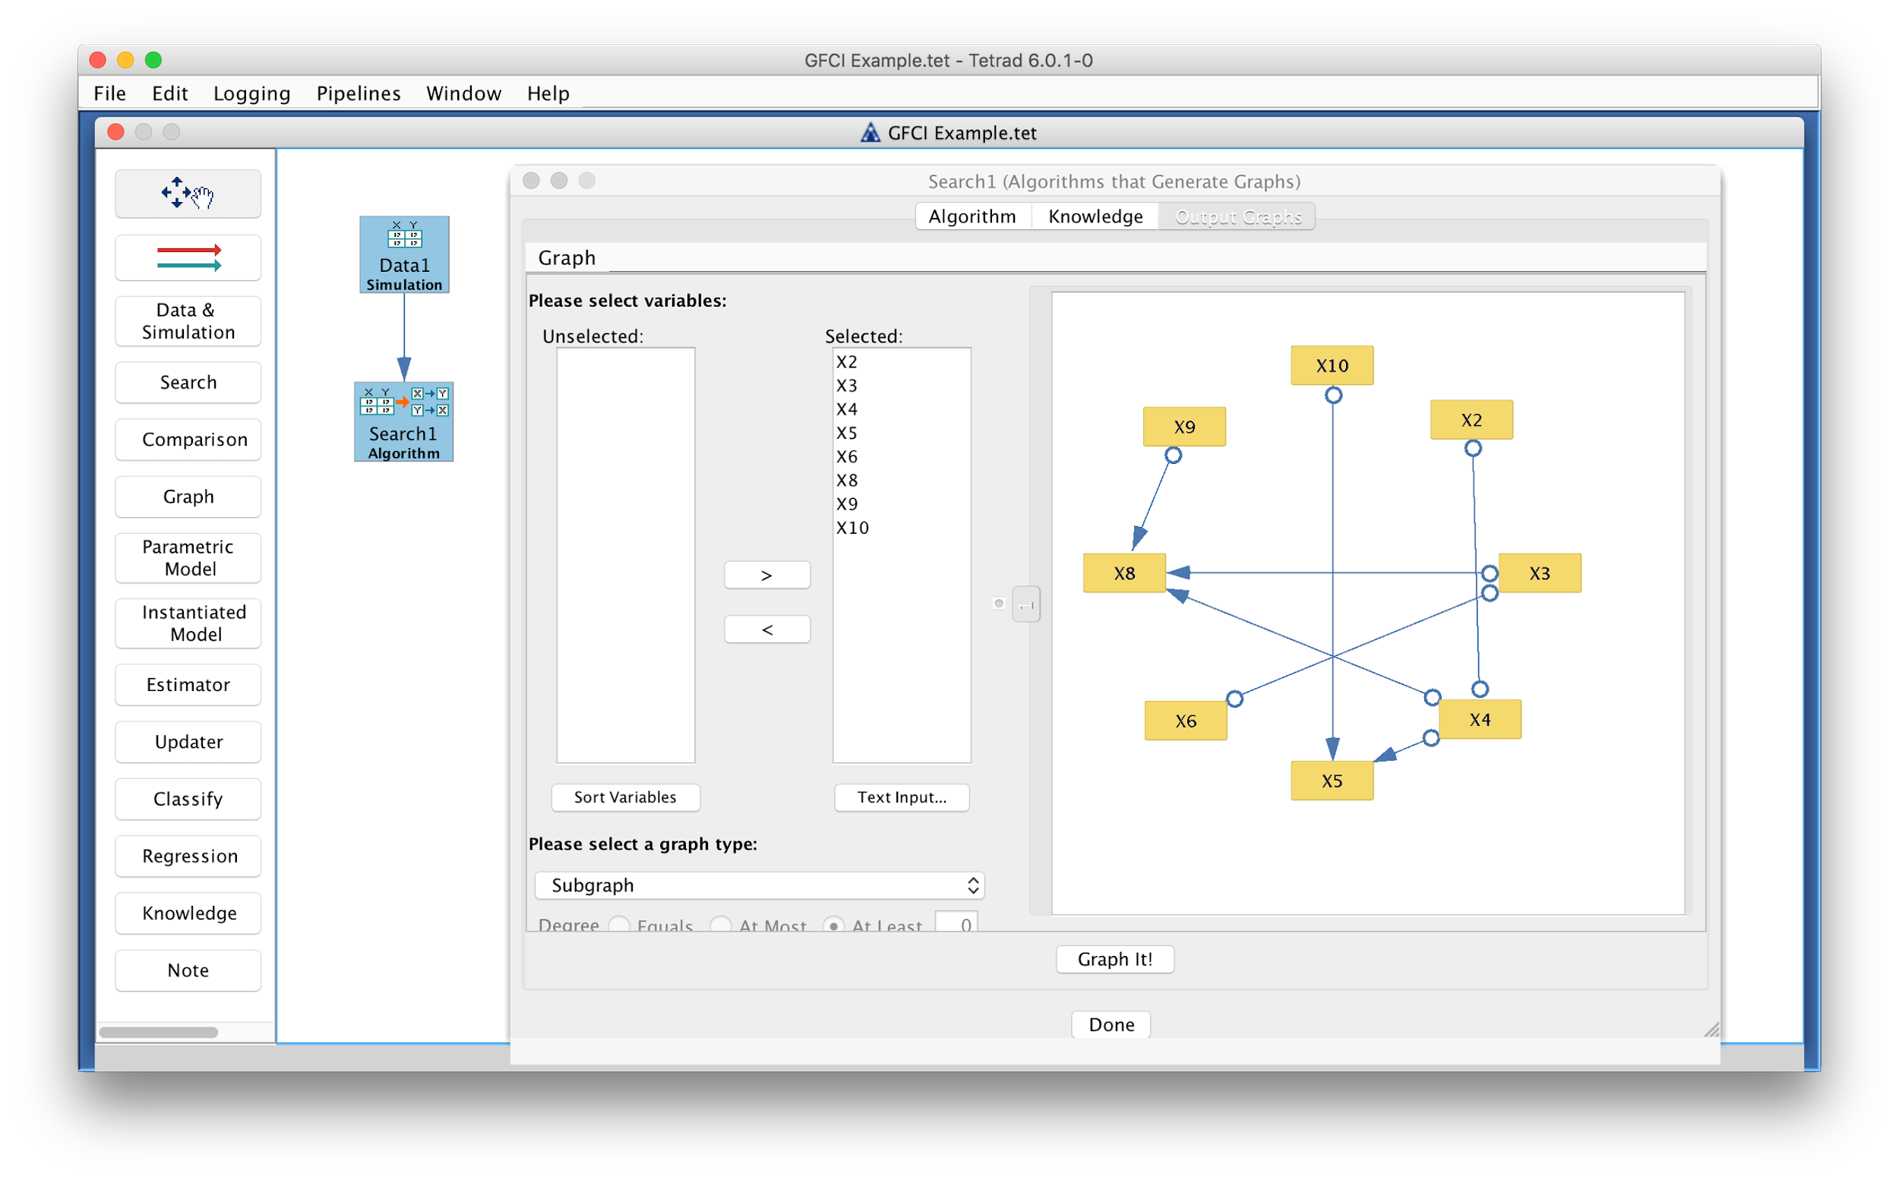
TETRAD, a free causal modeling software package
http://www.phil.cmu.edu/tetrad/

Slide 89
Causal Modeling Process
Prior Knowledge/
Domain Knowledge
Causal Inference
Inference Algorithm
Causal Assumptions
Set of Markov Equivalent Models
Real World
Data
Conditional Independence

Slide 90
Why are Causal Modeling stronger than other statistical methods?
D-separation criterion / Causal Inference
Prior Knowledge
Causal Assumptions

Slide 91
Causal Assumptions
Statistical methods employ statistical assumption such as normality, independence, homoscedasticity, etc. On top of these statistical assumptions, causal modeling adds causal assumptions
Causal Markov assumption: A variable X is independent of every other variable (except X’s effects) conditional on all of its direct causes.
Faithfulness: independencies within data is generated not by coincidence but by structure
Causal sufficiency: the set of measured variables M include all of the common causes of pairs in M

Slide 92
Limitations of Causal Modeling
Causal Assumptions
Markov Equivalent Structures

Slide 93
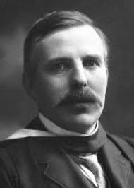
“If your experiment needs statistics, you ought to have done a better experiment.”
-Rutherford

Slide 94
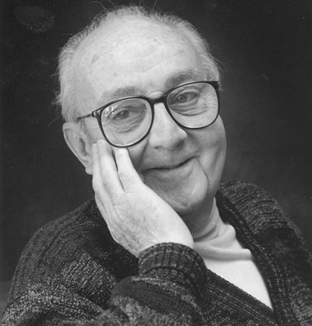
“All models are wrong, but some models are useful.”
-George E. P. Box

Slide 95
Graphical Modeling &
Deep Learning

Slide 96
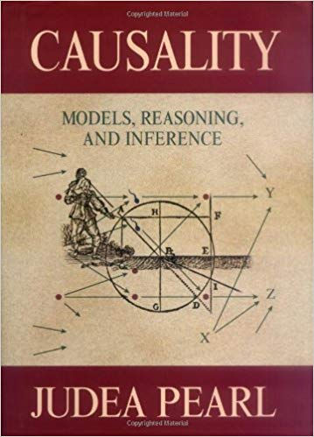
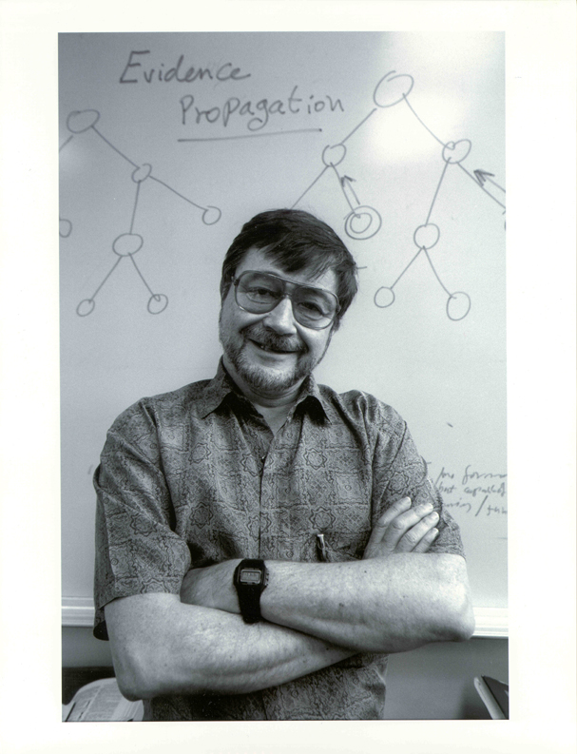
Judea Pearl: God of Causality

Slide 97
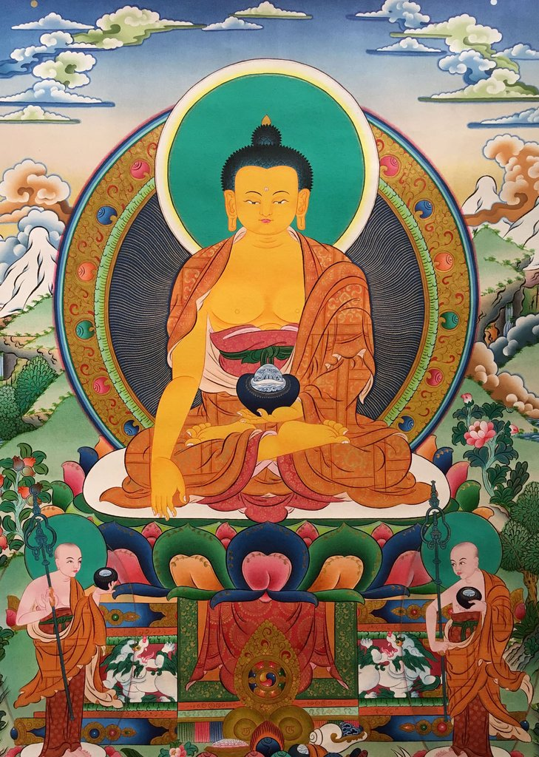
Pratītyasamutpāda: Dependent Origination

Slide 98

Open Challenge from Judea Pearl
“All the impressive achievements of deep learning amount to just curve fitting.
To Build Truly Intelligent Machines, Teach Them Cause and Effect”

Slide 99
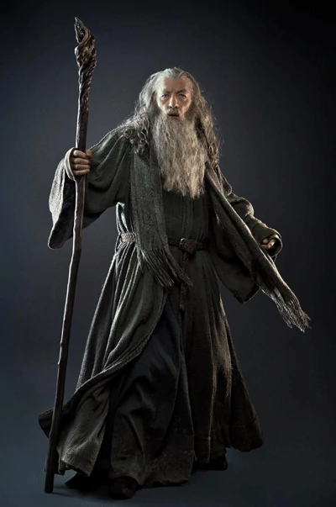

Open Challenge from Judea Pearl
Is Judea Pearl a Deep Learning Luddite?
or is he a provocative Gandalf?

Slide 100
Or do we even need to think in terms of either /or when talking about graphical models and deep learning? Are we at the verge of creating AI’s own unified theory?
AI’s own Maxwell’s equations?

Slide 101
Graphical Modeling &
Deep Learning
(Discussion)

